Slide 1
New World Beginnings
Contact: Europeans and Amerindians

Slide 2
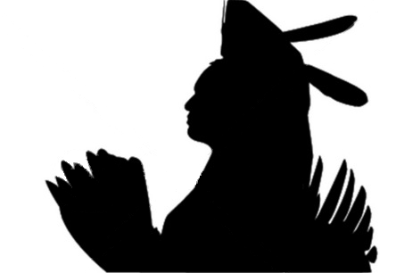
The First Americans
The Amerindians

Slide 3
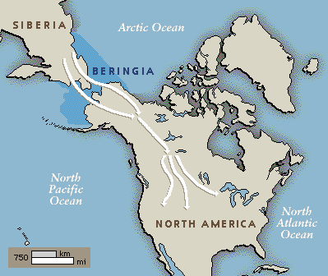
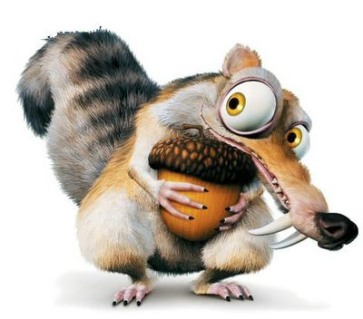
Coming to America
35,000 years ago, during the last Ice Age, hunters began crossing the Bering Strait as they followed migrating herds of big game.
Around 50-100 million inhabitants lived in the Americas before Columbus
Over 2,000 languages and widely differing cultures.

Slide 4
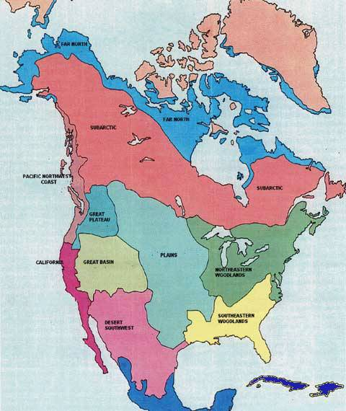
Northern Amerindians
North American Indians were less developed than their neighbors to the south, living in small semi-nomadic societies, e.g. Apache and Souix.
  Men were hunters, women developed agriculture and gathered wild vegetation.
Most societies were matrilineal (Family passed through mother’s lines) and matrilocal (women owned the property)
“You think you own whatever land you land on/The Earth is just a dead thing you can claim”

Slide 5
Who Really Discovered America?
-or- Why Columbus Was a Big Stinky Liar

Slide 6
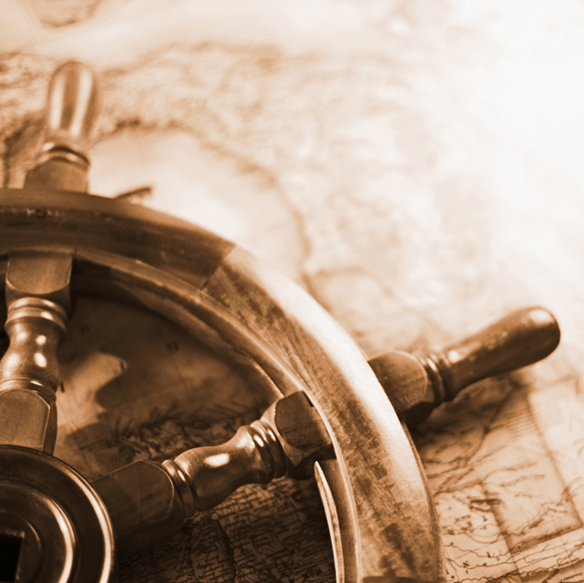
European Motives for Exploration
Europe’s motives for exploration can be linked to either the quest of God, Gold, or Glory:
Desire to Christianize
Europe was desperate for goods from Asia and the Middle East, and needed a faster and cheaper method of getting there.
Power and influence, rivalries with other nation-states

Slide 7
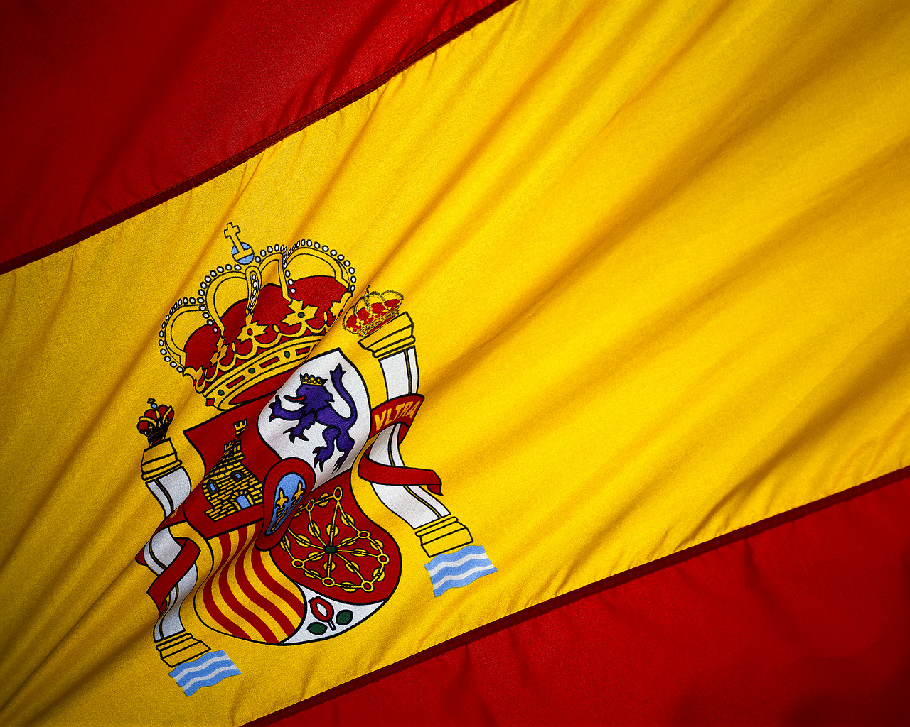
Spanish
Colonization

Slide 8
LIES MY TEACHER TOLD ME
Christopher Columbus

Slide 9
First off… Why did Columbus make his voyage?
Columbus, an Italian, was convinced that he could reach Asia faster by sailing west. Backed by Spanish monarchs, Columbus set sail with three ships and landed on present-day San Salvador Island.
  Did he really think he was in India?
    Yes, and no.

Slide 10

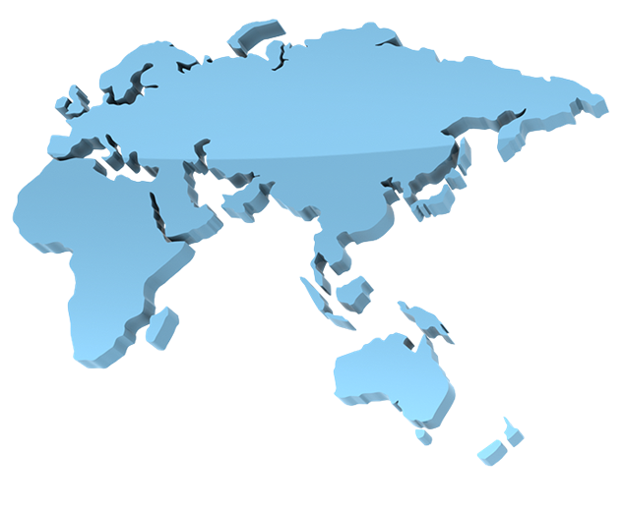

“How to Get to India”: European Edition

Slide 11
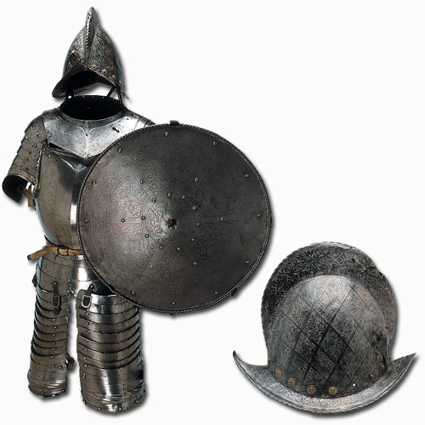
How was it possible for Columbus to conquer the new land?
Better Materials

Slide 12
and one more thing…
Oh…

Slide 13
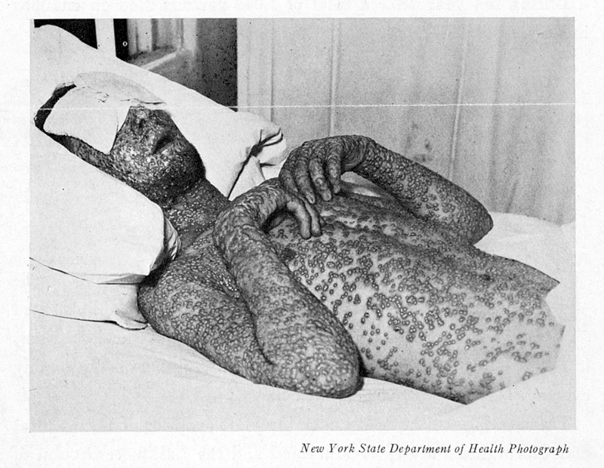
SMALLPOX!
Columbus’ men purposefully infected the blankets with diseases to make the natives easier to conquer.
Why do you think diseases like smallpox affected the natives to such a great degree?
The natives contracted these diseases from the blankets the Europeans gave them as “gifts”
An estimated 90% of Native Americans
were killed due to European diseases

Slide 14
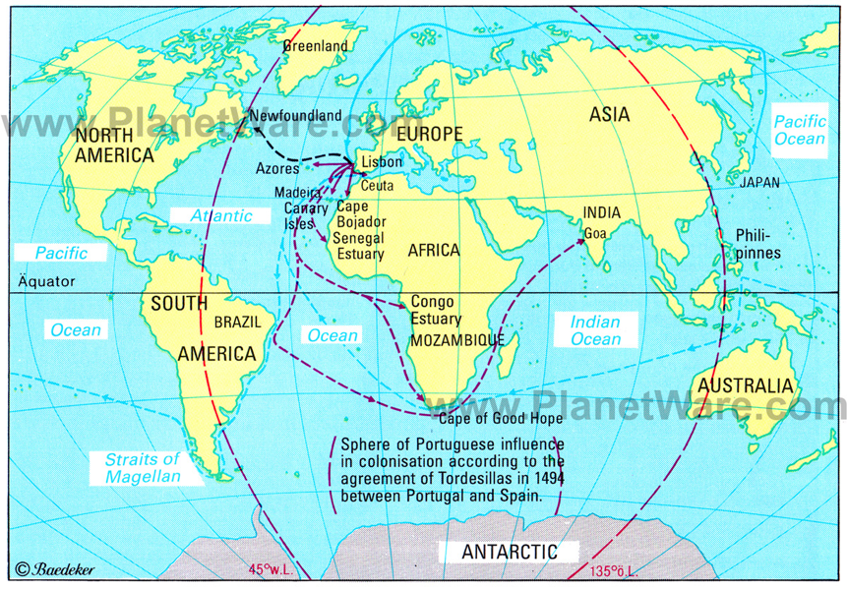
The Treaty of Tordesillas was an agreement between Portugal and Spain regarding to each country’s sphere of influence in the world for exploration.
The treaty also opened doors for others to begin exploring the New World as well.
Treaty of Tordesillas, 1494

Slide 15
The Columbian Exchange
The Columbian Exchange: The widespread exchange of plants, animals, food, and diseases between the Old World (Europe) and the New World (Americas).
Where do you think the following items came from?

Slide 16
 | Old World |  | New World
Animals | bee cat chicken cow | goat horse pig sheep | alpaca guinea pig llama turkey
Plants | almond apple banana black pepper carrot coffee citrus garlic lettuce | olive onion peach pea pear sugarcane tea turnip wheat watermelon | avocado bean bell pepper blueberry cashew chicle (chewing gum base) chili pepper cocoa maize (corn) peanut | pineapple potato rubber squash (incl. pumpkin) sunflower strawberry sweet potato tobacco tomato vanilla
Diseases | bubonic plague cholera influenza malaria measles | scarlet fever smallpox tuberculosis typhoid | syphilis yaws (disfiguring bone bacteria) yellow fever

Slide 17
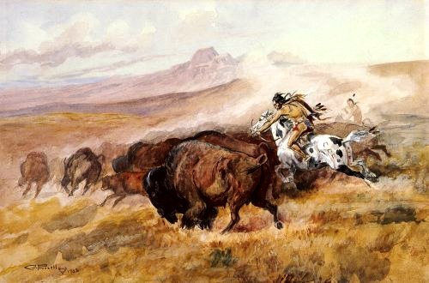
Results of contact between Native-Americans and Europeans
For Native Americans
Mass death and genocide: By 1600, nearly 90% of Native American population perished.
  European diseases, e.g., smallpox, yellow fever, malaria, most destructive.
European impact on culture: cattle, swine and horses, firearms.
Great Plains tribes--Apache, Blackfoot, and Sioux—transformed via horses.

Slide 18
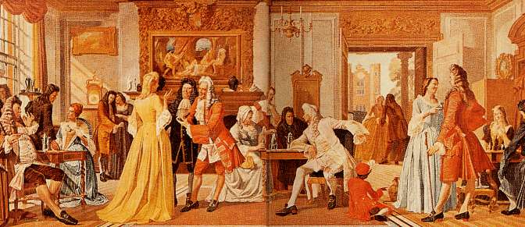
Results of contact between Native-Americans and Europeans
For Europeans
Global empires for 1st time in human history.
Explosion of capitalism (Commercial Revolution) Revolutionized the international economy.
Revolution in diet: Corn, beans, tomatoes & esp. potato lead to improved diet = higher mortality = higher population = bigger push for emigration. Stimulants: coffee, cocoa, and tobacco

Slide 19

The French

Slide 20
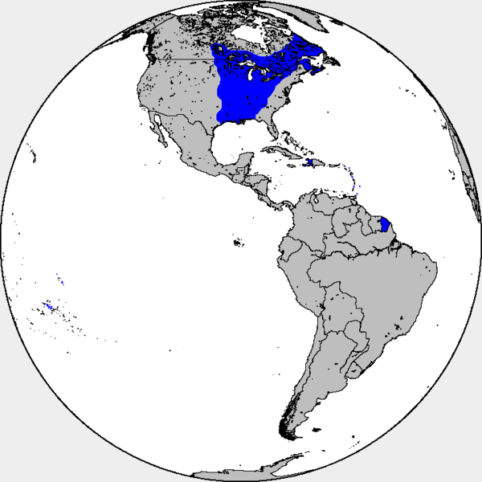

Settlements in Canada, the Mississippi River Valley, the port of New Orleans, and the Carribbean

Slide 21
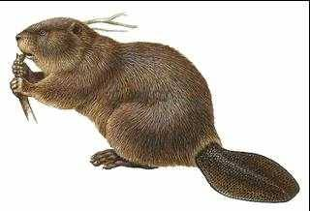
French Settlement
Most French settlers were young, single men
They were known as great gift-givers towards the Amerindians, a tradition of great importance in inter-tribal relationships
Focus was on fur trade, especially beaver pelts
Jesuits: Catholic missionaries who sought to convert the natives.

Slide 22
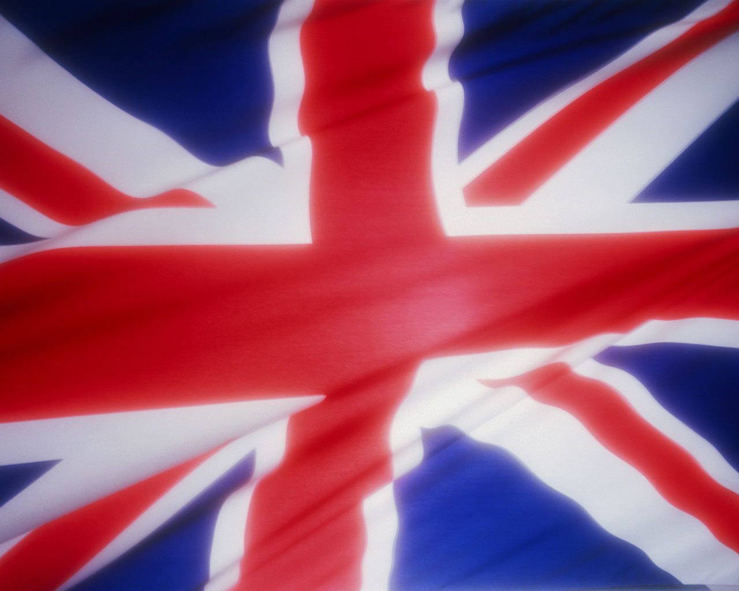
The English

Slide 23
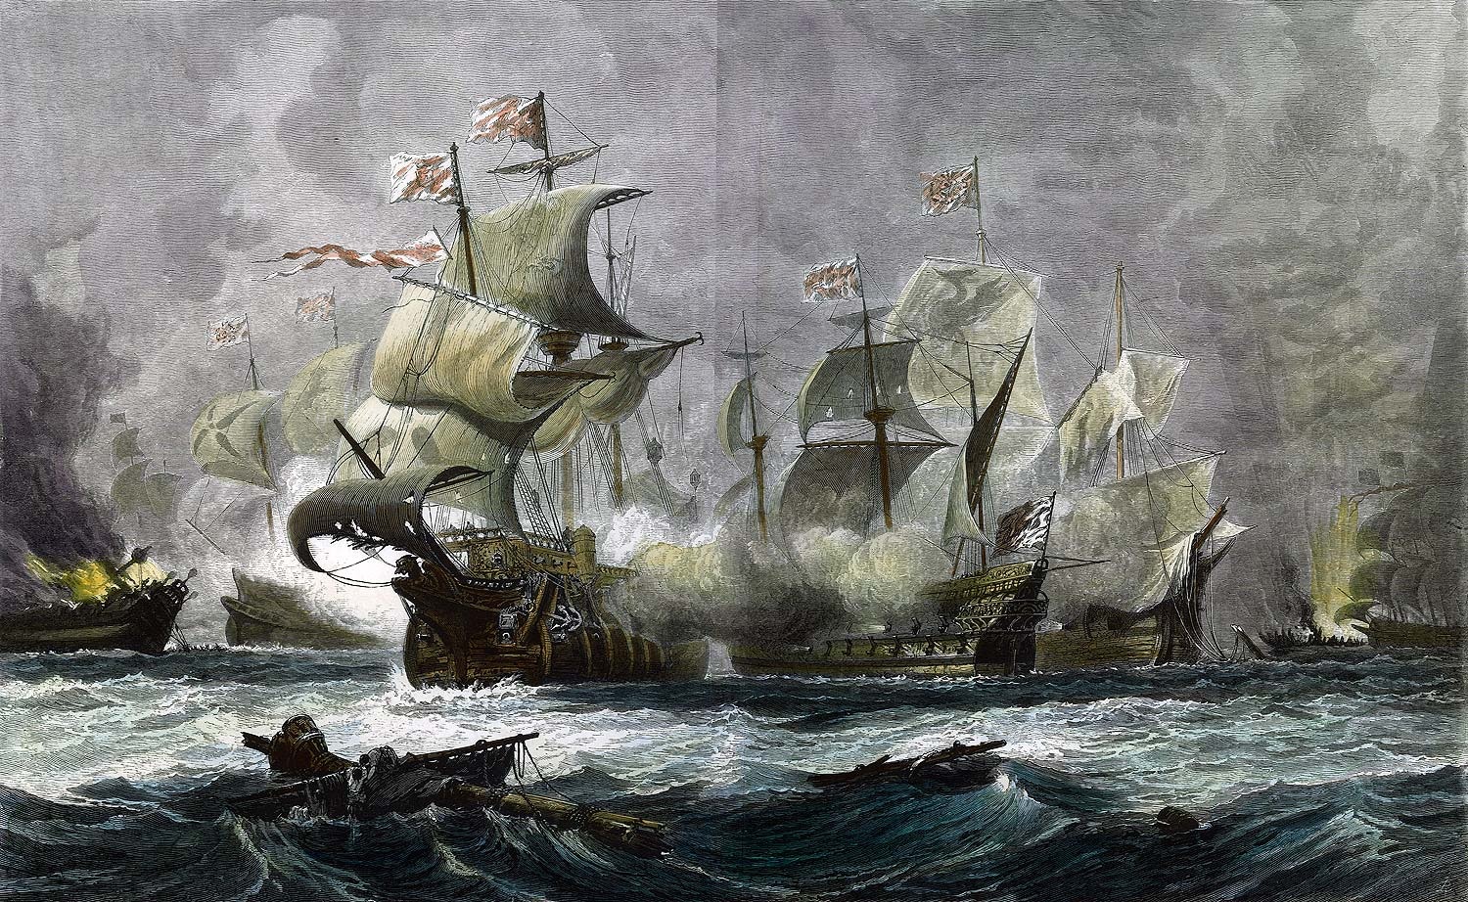
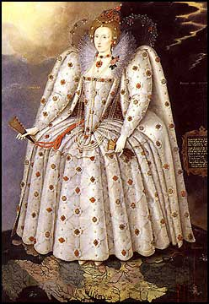
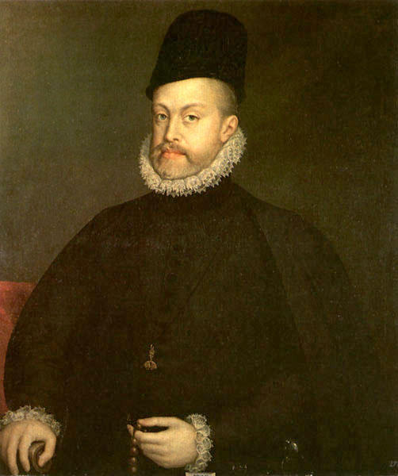
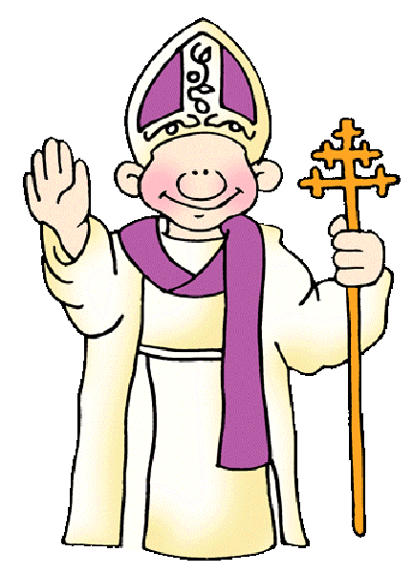
England v. Spain
Protestant England was in competition with Catholic Spain.
King Philip II sent the invincible Spanish Armada against England.
Severe storms and brilliant military planning allowed the severely outnumbered English to destroy the Spanish.
This changed the power structure of Europe.

Slide 24
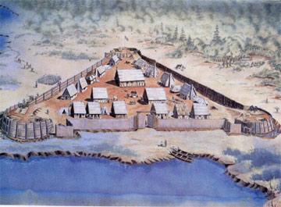
The First English Colony
Sir Walter Raleigh claimed part of the New World for England, naming it Virginia.
joint-stock company: A group of investors who pool their money to support big projects
  The Virginia Company
Jamestown (1607): the first English settlement in the New World.

Slide 25
LIES MY TEACHER TOLD ME
Pocahontas

Slide 26
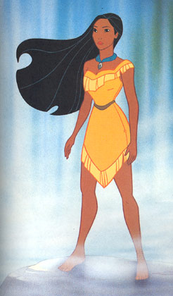
Once upon a time, there was a beautiful Indian princess

Slide 27
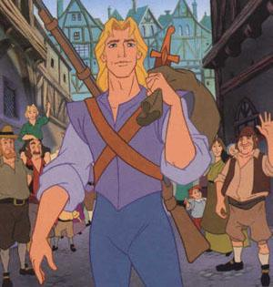
A handsome explorer landed nearby

Slide 28
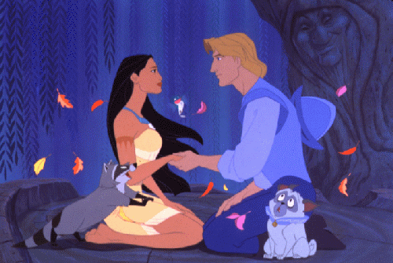
They met and fell in love

Slide 29
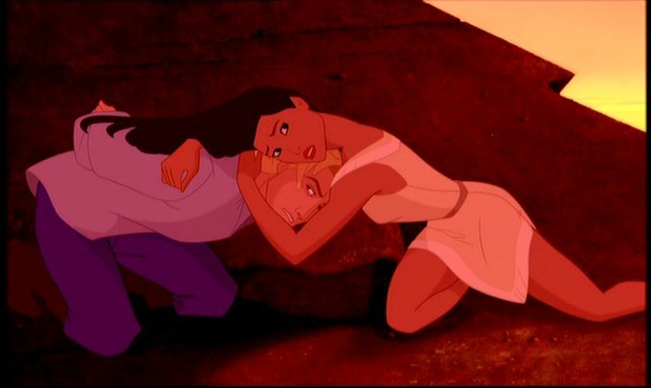
She saved him from certain death at the hands of her father

Slide 30
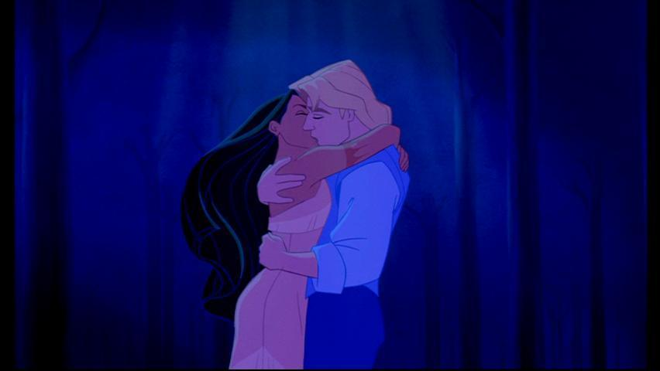
And they lived happily ever after.

Slide 31
LIES!

Slide 32
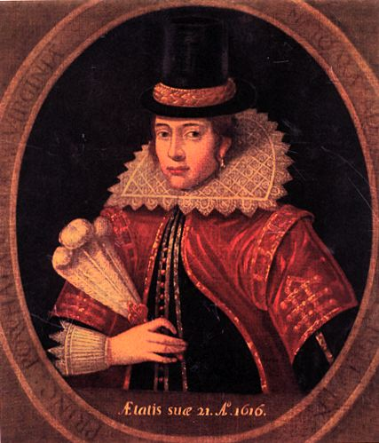
The REAL Pocahontas
She was in adolescence when Jamestown was founded
Was around 12 years old when she supposedly “saved” John Smith
Married John Rolfe, NOT John Smith
Died at the age of 22 in England of Small Pox

Slide 33
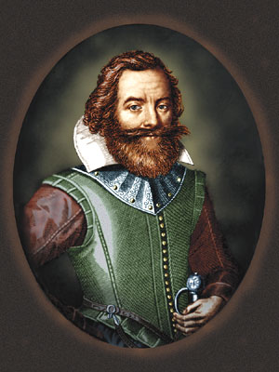
The REAL John Smith
Captain John Smith organized the colony beginning in 1608:
"He who will not work shall not eat."
Smith kidnapped in Dec. 1607 by Chief Powhatan
Smith perhaps "saved" by Pocahantas, Powhatan's daughter, but evidence is shaky at best.

Slide 34
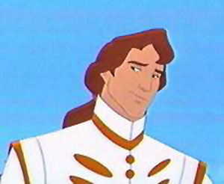
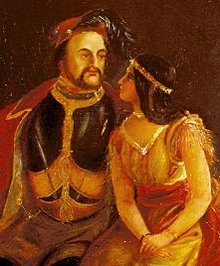
John Rolfe
The Disney Version
The REAL John Rolfe

Slide 35
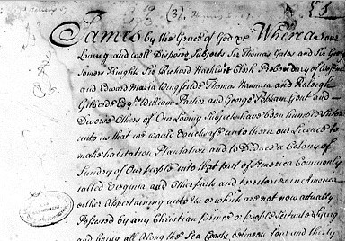
Jamestown
Virginia Charter
  Overseas settlers given same rights of Englishmen in England
  Foundation for American liberties; rights extended to other colonies.
  Colonists felt that, even in the Americas, they were still Englishmen

Slide 36
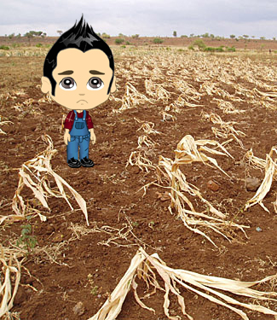
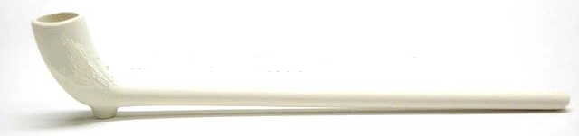
The Jamestown Nightmare
Jamestown nearly failed due to starvation, disease, and attacks by the Powhatans.
John Rolfe introduced new tough strain of tobacco given to him by the Powhatans
Europeans became increasingly addicted to the nicotine; Tobacco industry became cornerstone of Virginia's economy.
Plantation system emerged

Slide 37
The Thirteen Colonies
17th and 18th Centuries

Slide 38
The South
Greetings, y’all!

Slide 39
General Characteristics of the South
Dominated by a plantation economy = aristocratic atmosphere
Slavery in all colonies; begins as indentured servants, develops into African slavery
Sparsely populated: too spread out for churches & schools
Little diversity – either white landowners, or black slaves

Slide 40
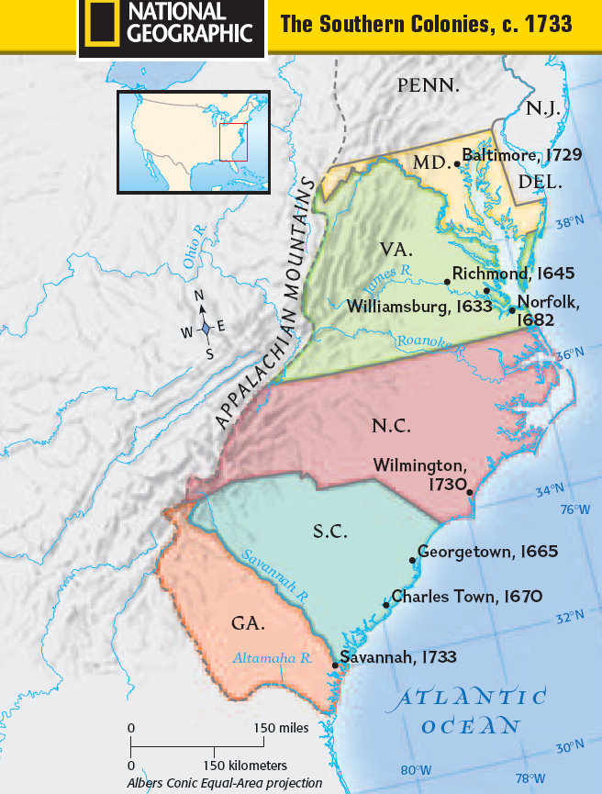
The Southern Colonies
MARYLAND
Proprietary colony
Lord Baltimore
Haven for Catholics
Act of Toleration
VIRGINIA
Jamestown (1607)
Joint-stock company
John Smith
John Rolfe
NORTH CAROLINA
Independent
Small farms
CAROLINAS
Proprietary colony
Founded by Caribbean plantation owners
SOUTH CAROLINA
Aristocratic
Plantation system
GEORGIA
James Oglethorpe
Buffer colony
Haven for debtors

Slide 41
The Northern Colonies
Harsh winters, Bad soil, and other exciting things…

Slide 42
General Characteristics of New England
Smaller, close-knit communities; centered around church and the family
Practiced democratic forms of government
Emphasis on education
Economy largely tied to fishing, shipping, farms were small (rocky soil, no need for slaves)
Least ethnically diverse region

Slide 43
The Protestant Reformation and the Rise of Puritanism
Christianity
Catholic
Protestant
Eastern Orthodox
Roman
Lutheran
Anglican
(Church of England)
Calvinism
Puritans
Separatists

Slide 44
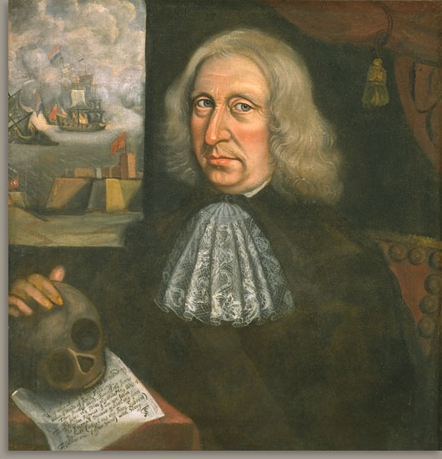
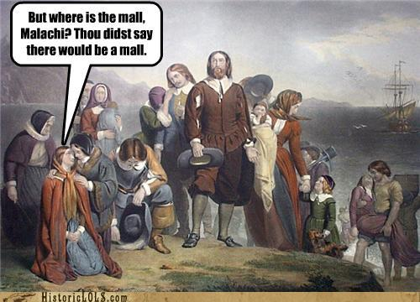
Puritans vs. Separatists
Puritans purify: Move away from the traditions of Catholicism
Separatists separate: The purest of Puritans (extremists)
The Pilgrims were Puritan Separatists

Slide 45
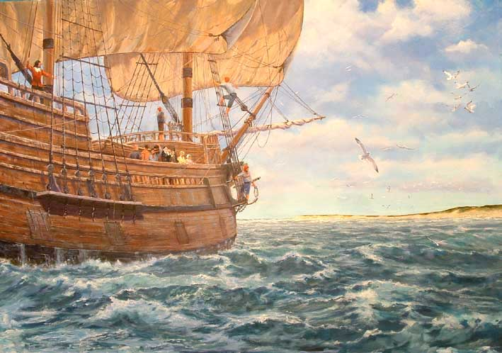
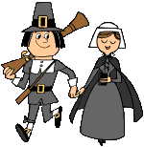
Who were the Pilgrims?
Separatists who believed they were “spiritual wanderers”
Plymouth Colony (1620) –102 people [half Separatists] set sail upon the Mayflower to start a colony

Slide 46
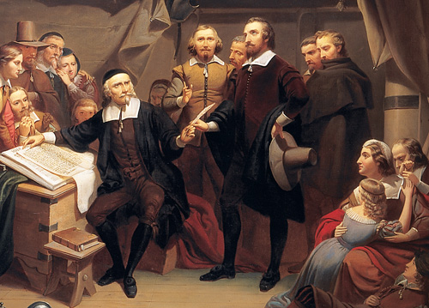
The Mayflower Compact
Not a constitution, but an agreement to form a crude govt. and submit to majority rule.
Led to adult male settlers meeting in assemblies to make laws in town meetings.
First democratic institution in America

Slide 47
Lies My Teacher Told Me
The Pilgrims and the First Thanksgiving
Notes:
47

Slide 48
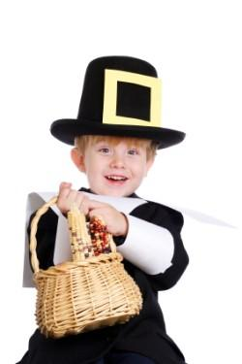
The Pilgrims and the First Thanksgiving
Notes:
48

Slide 49
LIES!

Slide 50

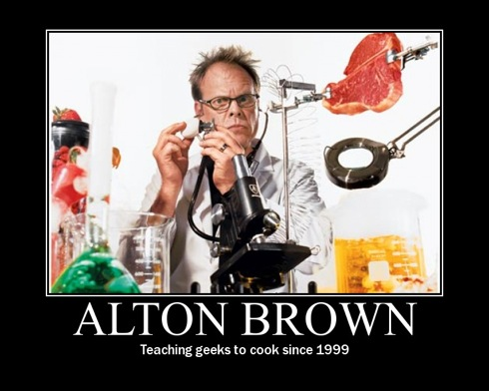
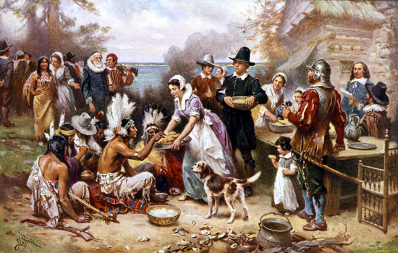
The First Thanksgiving
In 1863, President Lincoln proclaimed Thanksgiving an official US holiday.

Slide 51


Massachusetts Bay Colony
Created a “Bible Commonwealth” – a democracy run on Biblical principles
The top priority was to protect the institutions of marriage and family. This practice would result in strong communities.
  Modell of Christian Charity – “We shall be as a city on a hill…”
“Social Covenant”:
  Required mutual watchfulness.
  No toleration of deviance or disorder
  No privacy!

Slide 52
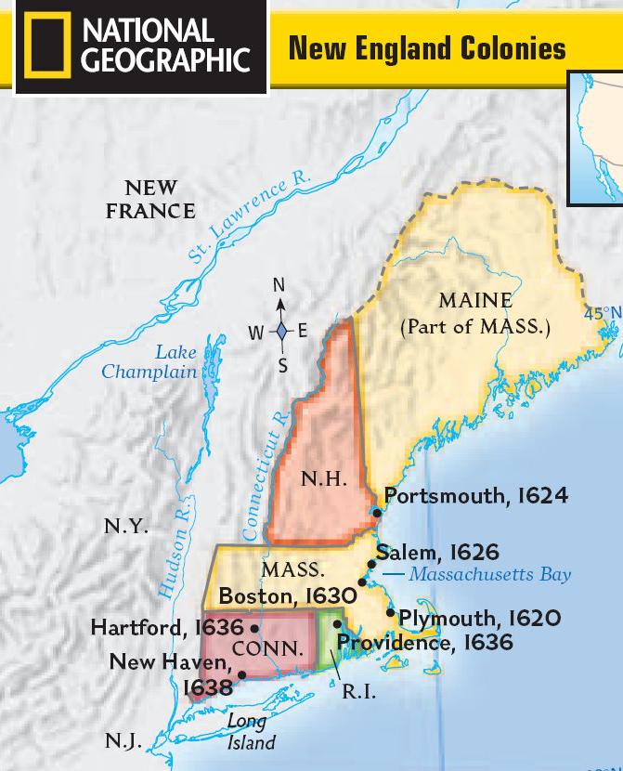
The Northern Colonies
MASSACHUSSETTS
PLYMOUTH (1620)
  Separatists
  Mayflower Compact
MASSACHUSSETTS BAY
  Puritans
  Absorbs Plymouth colony
  Bible Commonwealth
RHODE ISLAND
Roger Williams
Anne Hutchinson
Political and religious freedom
CONNECTICUT
Fundamental Orders of Connecticut

Slide 53
The Middle Colonies
The Middle Way in the Middle Colonies

Slide 54
General Characteristics of the Middle Colonies
Held a mix of NE and Southern colonies
  Had a mixed economy – some agriculture (like South), some industry and shipping (like NE)
  Landholdings were smaller than the South, bigger than NE
  More ethnically mixed than other colonies
  Had a mixed economy – some agriculture (like South), some industry and shipping (like NE)
  Most religiously tolerant region

Slide 55
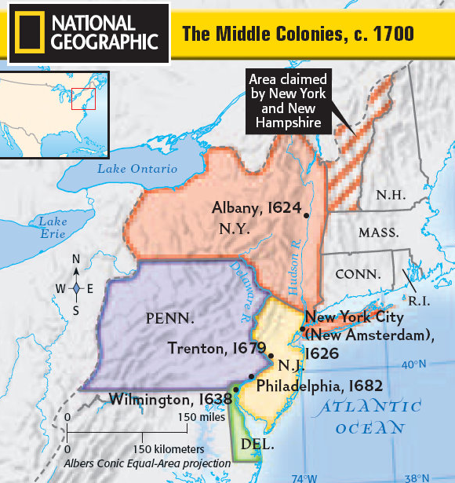
The Middle Colonies
NEW YORK
Founded by the Dutch
Taken over by the Duke of York
Large farms (patroonships) give aristocratic feel
PENNSYLVANIA
William Penn
Quakers
“Holy Experiment”
Religiously tolerant
Philadelphia

Slide 56

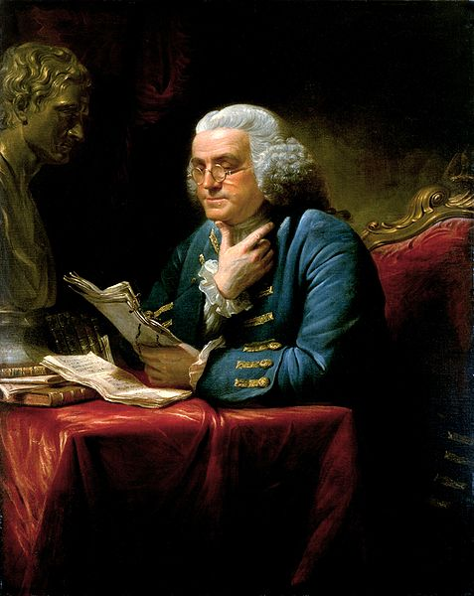
The Poster Child of the Middle Colonies: Benjamin Franklin 
Moved to Philadelphia from Boston at age 17, and worked his way up
One of America’s first “rags to riches” stories, he symbolized the independent American spirit
Author, printer, political theorist, politician, postmaster, scientist, musician, inventor, satirist, civic activist, statesman, and diplomat (and ladies man!).

Slide 57
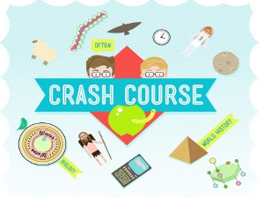
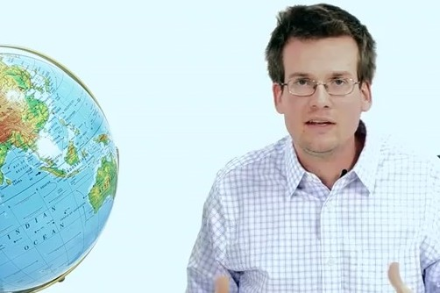
Crash Course!
King of the Geeks!

Slide 58
Bell Ringer
“It is dangerous to be right when the government is wrong.”
Explain this quote in your own words.

Slide 59
Life in the Colonies

Slide 60
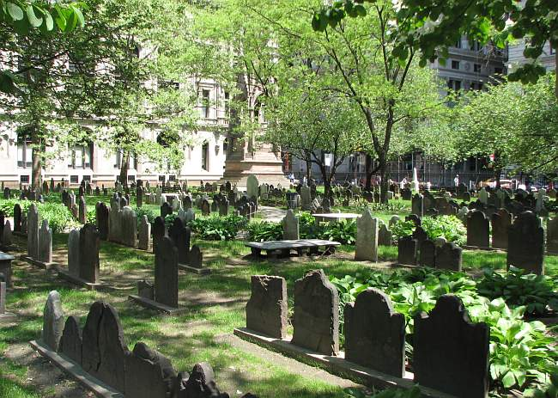
Population
South: Short life expectancy, Most immigrants were young, single men; women were extremely scarce
New England: Long life expectancy. Most immigrants came in family groups.
Middle: In the middle for life expectancy. Most diverse immigrant group.
Notes:
South: 10 years less than home in England due to disease; 50% not living past 20 years old.

Slide 61
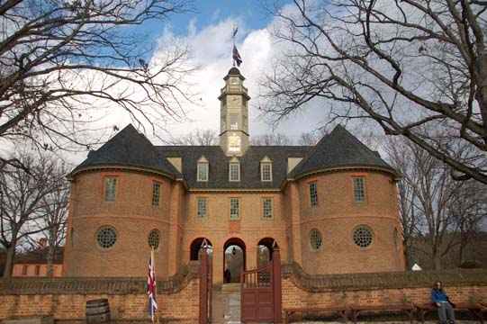
America’s First Government
The Virginia House of Burgesses was established in 1619 & began to assume the role of the House of Commons in England (control over finances, militia, etc.)

Slide 62
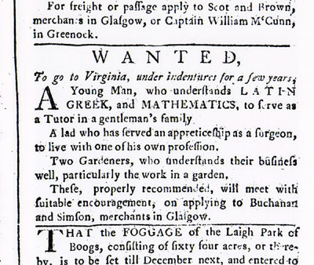
Indentured Servitude
England’s overpopulation led to high unemployment. There was a labor shortage in the colonies. The problem? No money to immigrate!
Indentured servants agreed to 5-7 years of labor in exchange for transatlantic passage
  Promised “freedom dues” [land, money]; were often ignored.
  Leads to large numbers of young, poor, unhappy men with little access to land or women for marriage.

Slide 63
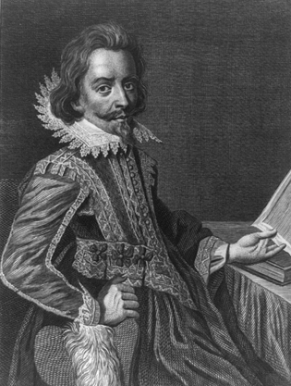

Bacon’s Rebellion - 1675
The HoB disenfranchised (took away voting rights) most landless men.
Led by Nathaniel Bacon, landless indentured servants cheated out of their freedom dues began violently attacking Indians for their land.
Governor William Berkeley ordered Bacon and his men to stop, and refused to retaliate for previous Indian attacks on white settlers.
Bacon’s men attacked the governor and burned Jamestown to the ground.
The rebellion fell apart when Bacon died suddenly of fever.

Slide 64

Effects of the Rebellion
The local tribes lost their remaining lands.
Upper class planters searched for laborers less likely to rebel: BLACK SLAVES!!

Slide 65

The Triangular Trade, Part 1

Slide 66



The “Middle Passage”

Slide 67


Roots of Slavery
First Africans arrived in Jamestown in 1619
Slave codes - Made blacks [and their children] property, or chattel for life of white masters.
  In some colonies, it was a crime to teach a slave to read or write.
  Could not meet in large groups, move about freely, or own property.

Slide 68

Salem Witch Trials
In 1692, a few girls claimed to have been bewitched by a Caribbean woman practicing voodoo.
Names were named, rumors spread, and innocent people were accused of being witches. Hysteria took hold and twenty people were executed.
By 1693, the Salem residents saw the recklessness for what it was and called it off.

Slide 69
Philosophical Changes in the Colonies
Breaking from Tradition

Slide 70

The Great Awakening
It was led by powerful “New Light” preachers who made Christianity intensely personal to the average person by appealing to their emotions, and by encouraging introspection and a commitment to a new standard of personal morality.
Jonathan Edwards - “Sinners In the Hands of an Angry God”
The Great Awakening was a spiritual revival that swept the colonies in the 1730s and 1740s.

Slide 71

The Enlightenment
The Enlightenment was a cultural movement of intellectuals in 18th century Europe and the United States, whose purpose was to reform society and advance knowledge through reason and logic.

Slide 72


Locke
Humans are all born free and equal, with three natural rights: life, liberty, and property.

Slide 73


Voltaire
“I may not agree with a thing you say, but I will defend to the death your right to say it.”
Man’s right to freedom of religion and speech must be protected, oui?

Slide 74


Montesquieu
Power should not be held by one man alone, but separated amongst several branches. Power should be a check to power.

Slide 75


Rousseau
Man is born free, and everywhere he is in chains. The sovereignty of the people is essential to the creation of a just government.

Slide 76


Beccaria
Just because you have been accused of a crime does not mean you shouldn’t be treated humanely. Torture should never be used. You should have a speedy trial and your punishment should fit the crime.

Slide 77


Wollstonecraft
If all men are born free, how is it that all women are born slaves?
Welcome to Stepford!

Slide 78


Smith
If humans freely follow their own self interest, government will be guided by an invisible hand. This is laissez faire.

