Slide 1
FDR and the New Deal
“The only thing we have to fear is fear itself.”

Slide 2
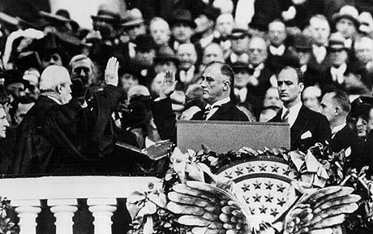
Roosevelt Takes Office
Herbert Hoover ran for a second term in 1932 and loses to Democrat Franklin D Roosevelt.

Slide 3
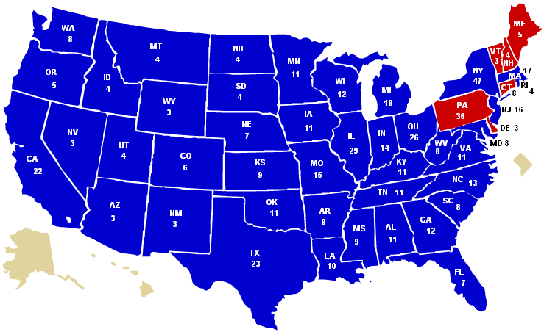

Slide 4
Background of FDR
1882-Born to wealth and privelage
1905- Married Eleanor Roosevelt (6 kids)
1921- Crippled by polio
1928- Elected governor of New York
1933-1945- President for 4 terms

Slide 5
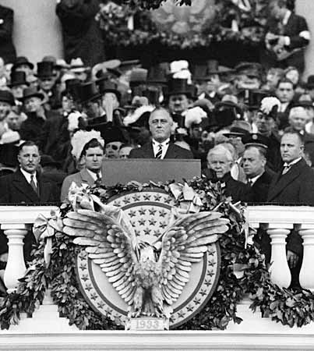
Inauguration of Roosevelt
He promised vigorous leadership and bold action
Called for discipline and cooperation
Expressed faith in democracy
Asked for divine protection and guidance

Slide 6
FDR’s view on the role of govt.
First time federal government directly gave people money
Created New Deal programs which provided many jobs

Slide 7
Bank Holidays
Unemployment continued to rise, bank runs increased
Many governors declared bank holidays, which closed the remaining banks before bank runs could put them out of business

Slide 8
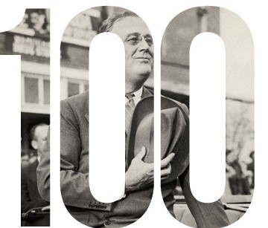
FDR’s first 100 Days
March 9-June 1933
Congress passed 15 major act to help economic crisis
These programs made up the first New Deal.

Slide 9
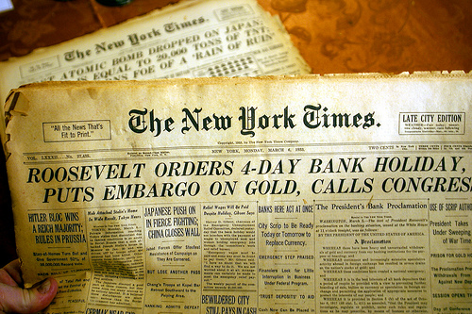
#1 Priority-Fix the banks!
FDR called a national bank holiday and called Congress into special session
Passed the Emergency Banking Relief Act, which required federal examiners to survey the nation’s banks and issue Treasury Department licenses to financially sound banks

Slide 10
Fireside Chats
Roosevelt spoke directly to the people, in his “fireside chat,” assuring Americans that banks were secure.
The following day, deposits in every city outweighed withdrawals, ending the banking crisis

Slide 11
First New Deal Programs

Slide 12
Purpose of the New Deal
The First New Deal created agencies that helped ease the burden of the Great Depression
GOALS of the Great Depression
Relief
Recovery
Reform
Overall objective: to provide a safety net to people

Slide 13
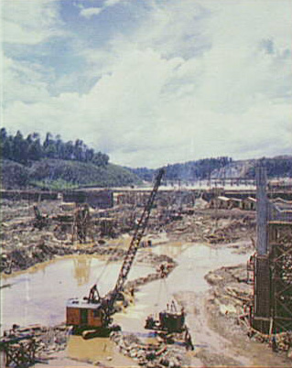
Tennessee Valley Authority
TVA- Built hydroelectric plants and dams aimed at improving 7 Southern states and attracting industry to the South.
Private power companies were against it because they received govt. subsidies

Slide 14
Civilian Conservation Corps
CCC-gave unemployed men 18-25 the opportunity to work with the national forestry service

Slide 15
Agricultural Adjustment Act
AAA-Paid farmers NOT to raise certain crops to lower crop production

Slide 16
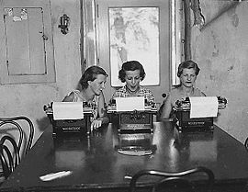
Federal Emergency Relief Administration
FERA-Channeled money to help state and local agencies fund relief projects

Slide 17
National Recovery Administration
NRA- Govt. was “hands on” in industry
Increased union membership
Controlled industrial production and prices with industry-created codes of fair competition
No longer around- declared unconstitutional in 1935

Slide 18
Federal Deposit Insurance Corporation
FDIC-Provided govt. insurance for bank deposits up to $2500.

Slide 19
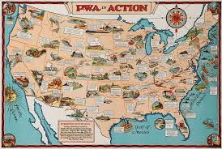
Public Works Administration
PWA- Series of construction projects, creating additional jobs

Slide 20
Civil Works Administration
Hired workers directly and put them on the govt. payroll

Slide 21
Securities and Exchange Commission
SEC-Created to regulate the stock market and prevent fraud

Slide 22
Challenges to the New Deal
After Roosevelt’s first 2 years in office, both sides of the political spectrum began to question FDR
Why were both sides opposed to the New Deal
Right (R)-Roosevelt had begun deficit spending to pay for these programs [borrowing money]
Left (D)- Roosevelt had not gone far enough. Shift more wealth from the rich to the middle class

Slide 23
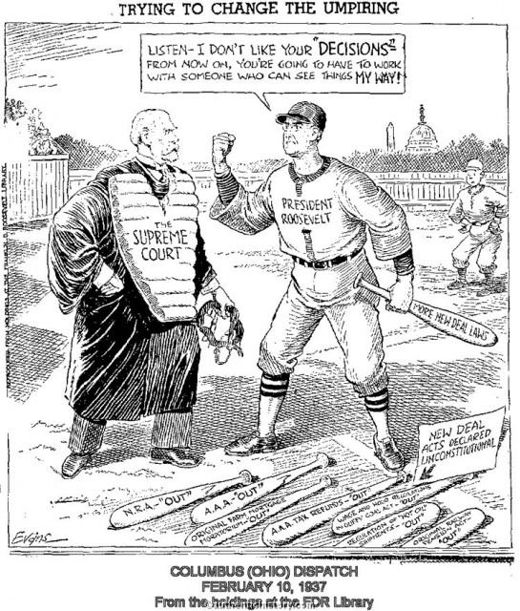
Supreme Court Says NO!
Supreme Court strikes down the NRA (unconstitutional)
Also struck down the AAA, on the grounds that agriculture was a local, not federal matter

Slide 24
FDR tries Plan B
Feb. 5, 1937, FDR announces plans to expand Supreme Court to 15 judges
Critics claim FDR was trying to “pack” the court and neutralize Supreme Court justices hostile to his New Deal
Congress said no, FDR criticized for trying to undermine the court (separation of powers)

Slide 25
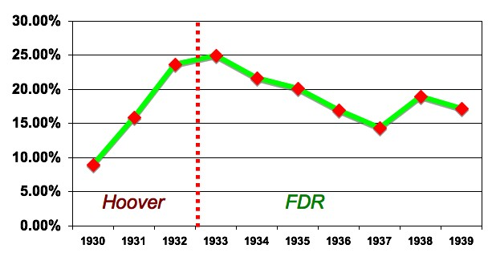
Unemployment Still High
The economy had improved during FDR’s first term, the gains weren’t as great as expected
Unemployment remained high and production still staggered

Slide 26
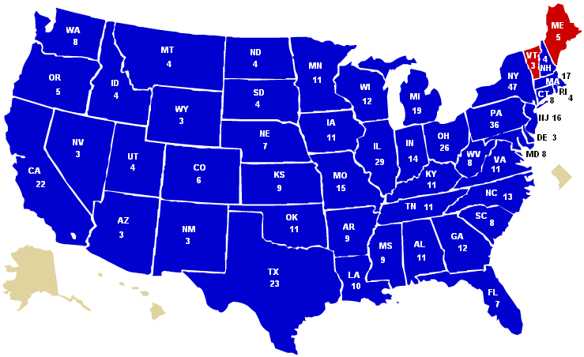

Slide 27
Second New Deal

Slide 28
Launching the Second New Deal
Aware of his doubters in 1935, FDR launched the Second New Deal
1935, asked Congress for funds to provide relief and increase jobs
Much of the $ would go to the Workers Progress Administration (WPA)

Slide 29
Workers Progress Administration
(WPA) spent $11 billion over several years, creating jobs for workers
Its most controversial aspect was offering work to artists, musicians, theater people and writers

Slide 30
Famous Artists
Painters like Edward Hopper, Thomas Hart Benton and Grant Wood were all made famous by their WPA artwork.
Photographer Dorthea Lange gained fame from her photos during this era

Slide 31
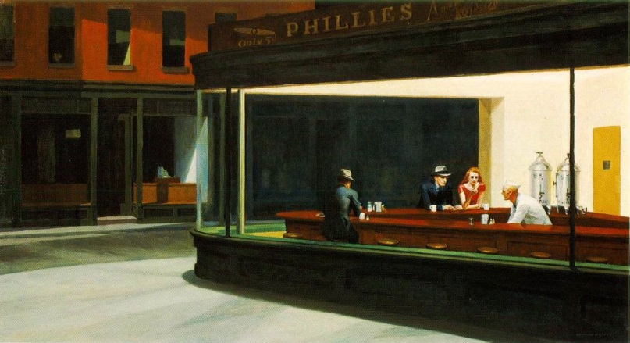

Slide 32
Congress of Industrial Organizations
CIO-Organized industrial unions, skilled and unskilled workers
Between the 1930s-50s, labor unions benefited Industrial workers

Slide 33
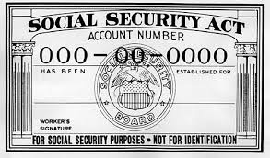
Social Security Act (SSA)
Provided some security for the elderly (65+) and for unemployed workers
Provided welfare for needy people
Social Security set the principle that the fed. Govt. should be responsible for people who, through no fault of their own, were unable to work

Slide 34
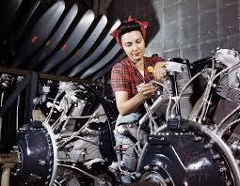
New Deal Era comes to an end
1942- WWII puts everyone back to work

Slide 35
Legacy of the New Deal
Limited success, unemployment remained high
Economic recovery was not complete until after WWII
Despite all these negatives, the New Deal gave Americans a stronger sense of security and stability

Slide 36
What about Eleanor?
National Youth Administration (NYA): Gave students grants in exchange for work
Proposed New Deal programs that supported nursery schools as well as nutrition programs in schools

Slide 37
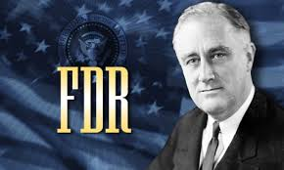
Role in Government Changed
FDR left many Americans feelings that it was government’s job to provide a safety net
This increased the role of govt. in people’s lives
Critics argue New Deal made govt. too powerful
Another legacy that is debated is how much should a govt. provide support

