Slide 1
Rise of the Dictators

Slide 2
World Wide Depression
Most of the world suffers from depression after WWI
Germany suffers from hyperinflation: money becomes worthless
Allies are unable to payback loans to the US

Slide 3
The Dawes Plan
Former allies were having trouble paying off war debt because of America’s high tariffs
Germany couldn’t pay reparations to Allies
Charles Dawes-American Banker-negotiated an agreement between Britain, France and Germany
America would loan money to Germany in order to pay reparations so Britain and France could pay off war debt to America

Slide 4
The Dawes Plan drew the American financial system into Europe’s problems and when Germany couldn’t pay either its loans or its reparations, American Banks suffered the default of German, British and French loans simultaneously

Slide 5
Benito Mussolini

Slide 6
Benito Mussolini
Post war discontent in Italy
Former journalist, editor or Avanti
After serving in WWI, thought Italy needed stronger nation
Mar. 1919, founded the Fascist Party
Blackshirts planned to take over the govt., the king caved into his demands and made him Prime Minister in 1922

Slide 7
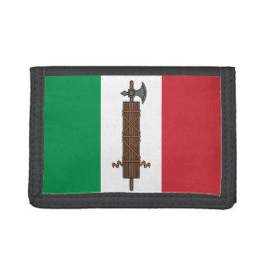
What is Fascism?
Fascism is an aggressive nationalist belief that the nation is more important than the individual
They believed that a nation can only be great by having a powerful military and the extension of its borders

Slide 8
Characteristics of Fascism
Rejection of Democracy
Power vested in the Dictator
A heavy reliance on political symbolism

Slide 9
Adolf Hitler

Slide 10
Adolf Hitler
Disgruntled artist that became homeless
Enlisted in WWI, became a messenger
Hatred of the Allied powers after WWI because of the terms they set for Germany with the Treaty of Versailles
After the war, became a spy for the military

Slide 11
Rise of the Nazi Party
Originally called the German Workers Party
Hitler was asked to spy on the organization, found out he actually agreed with their beliefs and became a member
Admirer of Mussolini: Studied the way he spoke
Formed their own private army: Stormtroopers
After the Beer Hall Putsch in 1923, Hitler sent to jail, serves one year

Slide 12
Adolf Hitler
Writes Mein Kampf while in jail; published in 1925
Learns that if you want power, must do it legally
Jan.1933, becomes Chancellor of Germany
After death of Hindenburg, he becomes dictator in Aug. 1934

Slide 13
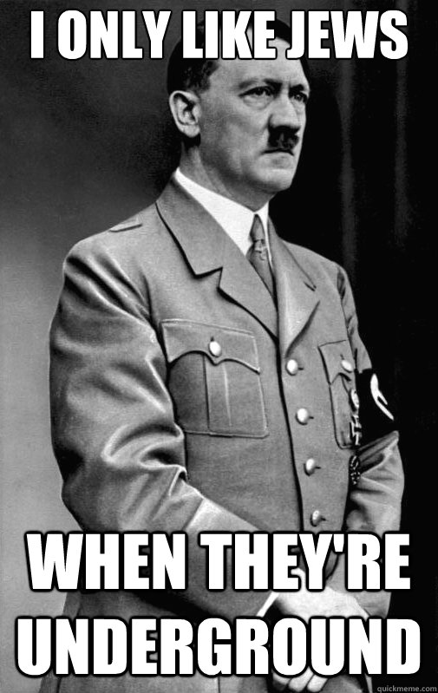
Conclusions from Mein Kampf
1) Jews are ruling Russia
Jews should be decomposed
The only way for Lebenstraum (living space) is to use military force

Slide 14
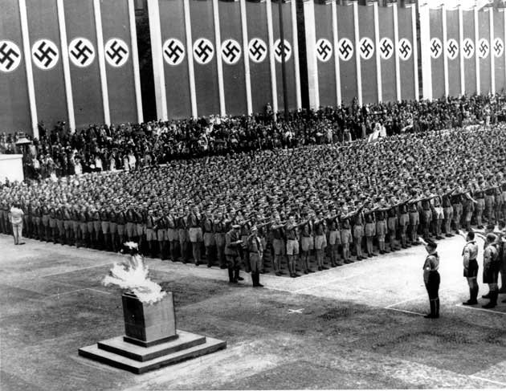
Conclusions from Mein Kampf
2) In order for Germany to be strong again, they need a strong military

Slide 15
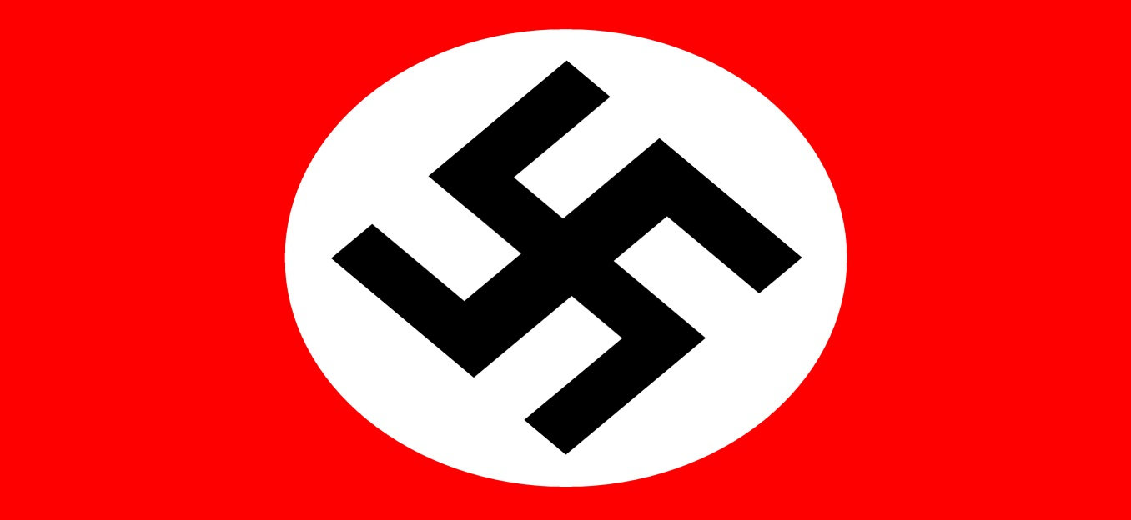
Conclusions from Mein Kampf
3) Hitler created the German flag
It symbolizes nationalism, struggle for victory and anti-Semitism.

Slide 16
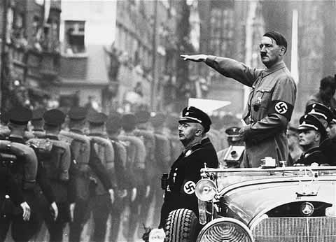
Conclusions Mein Kampf
4) The Nazi party will be victorious
The Aryans should be lord of the earth

Slide 17
Stalin and the Soviet Union
1917, Bolsheviks, led by Vladimir Lenin, established communistic governments within Russia
In 1922 they renamed these territories the USSR (Union of the Soviet Socialist Republics)

Slide 18
Stalin and the Soviet Union
The suppressed individual liberties and punished opponents
In 1924, Lenin died, power struggle ensued
In 1926, Stalin became leader
Killed 8-10 million peasants who resisted Communist policies

Slide 19
Hitler’s Demands
Hitler called for unification of German speaking people
Seizing Austria and Czechoslovakia would give Germany food supplies, defensible frontiers and soldiers

Slide 20
Hitler’s demands
Hitler threatened Austria of an invasion if they didn’t appoint Nazi’s to important govt. posts
Austria gave in, but not fully
Put the matter of unification up for a democratic vote
Fearing the outcome, Hitler invaded

Slide 21
Munich Crisis and Appeasement
Hitler claimed Sudetenland, and area of Czechoslovakia with a large German speaking population
Czechoslovakia strongly resisted, was allied with France and the Soviet Union
France and the Soviet Union promised to support Czechoslovakia if Germany invaded

Slide 22
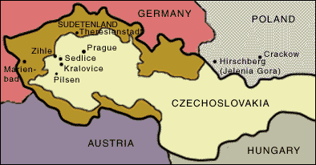

Slide 23
Munich Conference: Sep. 29, 1938
Representatives of Britain, France, Italy and Germany met to discuss Sudetenland
Britain and France agreed to appeasement: let Hitler have Sudetenland in exchange for peace

Slide 24
Munich Conference: Sep. 29, 1938
Czechoslovakia was informed that they had to defend the Sudetenland themselves
Oct. 1, 1938, Germany sent troops through the Sudetenland
Months later, Germany invades the rest of Czechoslovakia, Britain and France do nothing

Slide 25
Nazi-Soviet Non-Aggression Pact (August, 1939)
Also known as Molotov-Ribbentrop Pact (they were foreign ministers)
Deal between Germany and the Soviet Union that they would not go to war with each other
Secret part of the treaty that they would divide Poland and other countries

