Slide 1
The Great Society

Slide 2
Bell Ringer 5/5 (left)
What does it take to make a Great Society?
Write the question

Slide 3
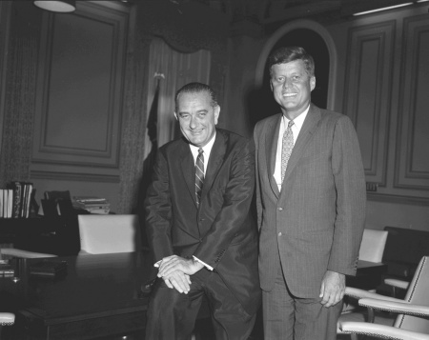
LBJ’s Goals
To extend the policies of JFK

Slide 4
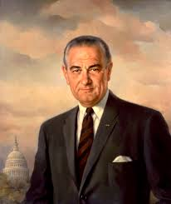
A new president
Johnson was raised in poverty
Taught in a low income school
Was direct and to the point
Rough image

Slide 5
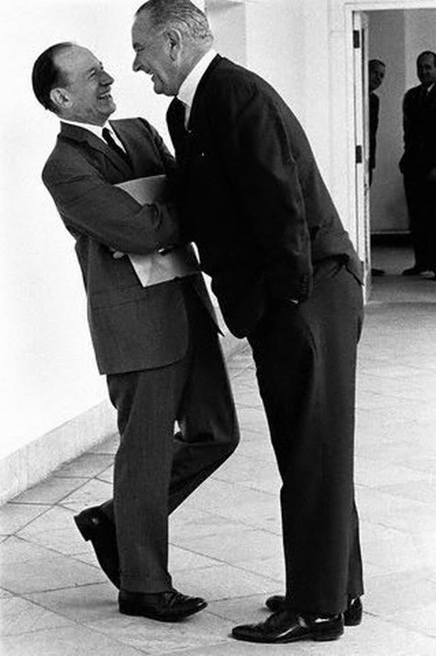
The Johnson Treatment
When Johnson became president, had 26 years of Congressional experience
Guy that got things done by doing favors, bargaining and even threatening

Slide 6
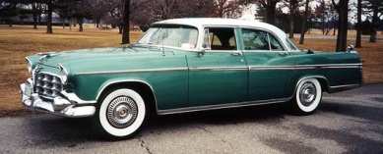
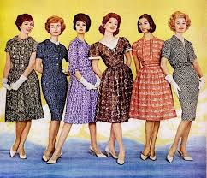
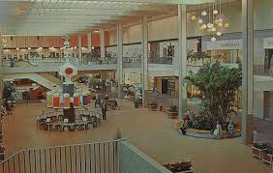
America in the early 60s
Appeared to be economically prosperous
Roads and suburbs
Cars
Shopping malls
Fashion booming

Slide 7
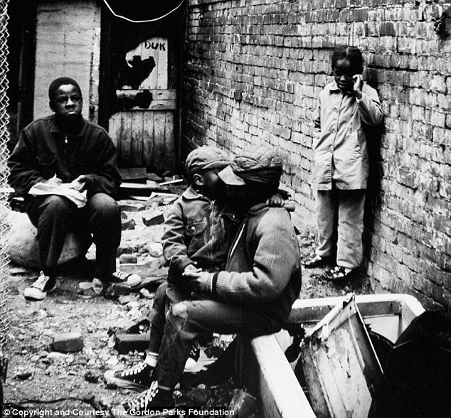
Reality?
Extreme poverty (50 million)
Starving
Homeless
Not educated
City slums, rural areas, in Deep South, Indian reservations

Slide 8
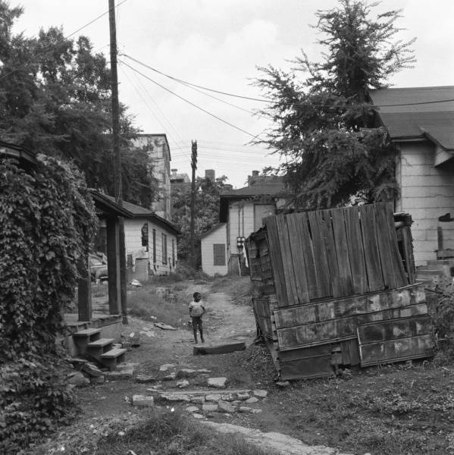
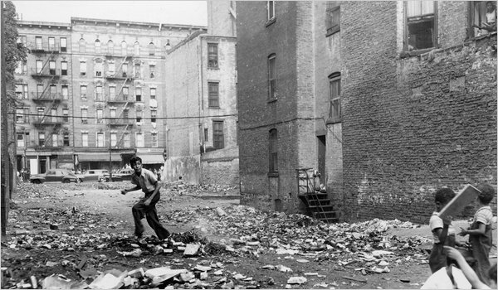
Great Society
Johnson’s vision of more perfect and equitable society
Chief objective: help impoverished and disadvantaged in America

